Slide 1
StudENT INTEREST SYSTEM
EAD Project-II

Slide 2
Er Diagram
Arslan Adrees BCSF20M019

Slide 3
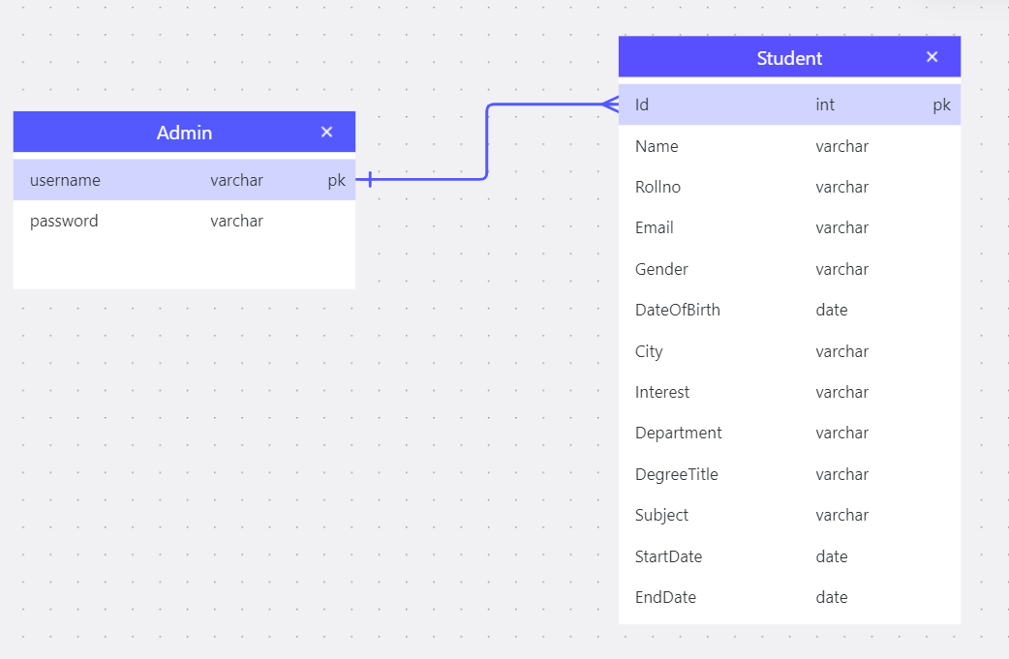
Can add, edit, delete

Slide 4
Application Flow
User login the system
He can see the Dashboard which is displaying the valuable statistics of student interest database in the forms of charts and graphs.
He can add the student by clicking on the Add Student page shown in header bar and put the necessary information of student by filling the form. Now click the Add button to create student in database otherwise click the Cancel button to go back.
There is a Students page where the list of all the student have been shown along with the functionalities of view, edit or delete the particular student, Searching and pagination.

Slide 5
Choose of technology stack
ASP.net MVC C# has been chosen to implement this project.
Model-view-controller (MVC) is a popular architecture pattern for developing applications. It separates the data, logic, and presentation layers. The main purpose of MVC is to separate the concerns of your code, and to make it easier to maintain, test, and reuse.

Slide 6
Choose of font & colors
Standard fonts
These fonts are easier for search engines to recognize and are more likely to be installed on users' devices. Some examples include Arial, Times New Roman, and Verdana.
Coloring scheme is chosen according to the Color Psychology like Some colors can convey certain feelings or ideas. For example, blue is versatile and universally liked, while purple can convey creativity, wisdom, and confidence.

